Slide 1
DEPARTMENT OF ELECTRONICS AND COMMUNICATION ENGINEERING Academic Year 2024-2025 (EVEN SEM)
ECB1223 – MICROCONTROLLERS AND INTERFACING

Slide 2
BIKE ANTI-THEFT ALERT SYSTEM
Team members Guide Name
DHARSHINI.K.C(927623BEC37) Dr.K.SIVANANDAM
DHARSHINI.T(927623BEC039)
GOWSIGA.S(927623BEC061)

Slide 3
OBJECTIVE
The goal of this project is to develop and prototype a smart Bike Anti-Theft Alert System employing a microcontroller (NodeMCU), GPS, relay module, and IoT technology.
THE SYSTEM SHOULD:
Track the location of the bike with a GPS module.
Trigger real-time alert messages to the user through the Blynk IoT app if there is any unauthorized movement or tampering.
Disable the ignition system remotely using a relay module operated via the app.
Run on a portable power source, thus being ideal for use in bikes.

Slide 4
PROBLEM STATEMENT
Motorbike theft is a rising issue in urban and rural settings. Conventional locking systems are frequently not effective in deterring theft, and the owners usually do not have access to live data concerning their bike's security status. A cost-efficient, intelligent anti-theft system is needed that not only immobilizes the vehicle remotely but also locates it and sends real-time alerts to the owner through smartphone.

Slide 5
LITERATURE SURVEY
1.Smart Vehicle Anti-Theft System Using GSM and GPS" – International Journal of Engineering Research and Technology (IJERT), 2017
LIMITATION: Does not provide any mobile application or real-time app notification support. Control only over SMS-based commands.
2. "Design and Implementation of Vehicle Tracking System Using GPS/GSM/GPRS Technology" – IEEE, 2015
OVERVIEW: Suggested a GPS vehicle tracking system combined with GSM for communications.
LIMITATION: Tracking passive; no active theft deterrence features such as remote immobilization or notifications via smartphone applications.

Slide 6
PROBLEM ANALYSIS
1.No Real-Time Alerts:
Typical systems are not able to alert the user in real time when stealing is happening.Before the owner realizes it, the bike can be already relocated or stolen.
2.No Remote Control or Action:
There is no means of reacting in real-time (e.g., remotely stopping the bike).There is a requirement for a remote ignition control or immobilizer.
3.No Location Tracking:
After a bike is stolen, recovery is not easy without a GPS tracker.Owners have to depend on police or CCTV, which is slow and unreliable.
4.Relying on GSM (SMS-based) Communication:
Most of the current systems are based on SMS alerts over GSM, which is delayed and less reliable compared to IoT-based solutions over Wi-Fi/mobile data.

Slide 7
SOLUTION
The proposed motorbike anti-theft system is a cost-effective and intelligent solution designed to enhance bike security. It uses a microcontroller integrated with sensors to detect unauthorized movement, a GPS module to track real-time location, and a GSM or Wi-Fi module to send instant alerts to the owner's smartphone. The system allows remote immobilization of the bike through a relay, preventing theft. With continuous monitoring and real-time notifications via a mobile app, this solution provides reliable protection against motorbike theft in both urban and rural areas.

Slide 8
TECHNOLOGY ADOPTED
1.Microcontroller: NodeMCU (ESP8266/ESP32):
Integrated Wi-Fi supports real-time communication with the Blynk cloud.Interfaces with relay modules, GPS, and sensors.
2. IoT Platform: Blynk App:
Send notifications to the user.Show bike location (via GPS).Control enable/disable relay (remote ignition control).
3. GPS Module (e.g., NEO-6M):
Offers real-time location tracking of the bike.Transmits latitude and longitude coordinates to the NodeMCU.Location is shown on the Blynk app or utilized to locate the bike in case of theft.
4. Cloud Connectivity:
Blynk Cloud is the connection bridge between NodeMCU and mobile app.Ensures secure, fast transfer of data and notifications via Wi-Fi or cellular hotspot.

Slide 9
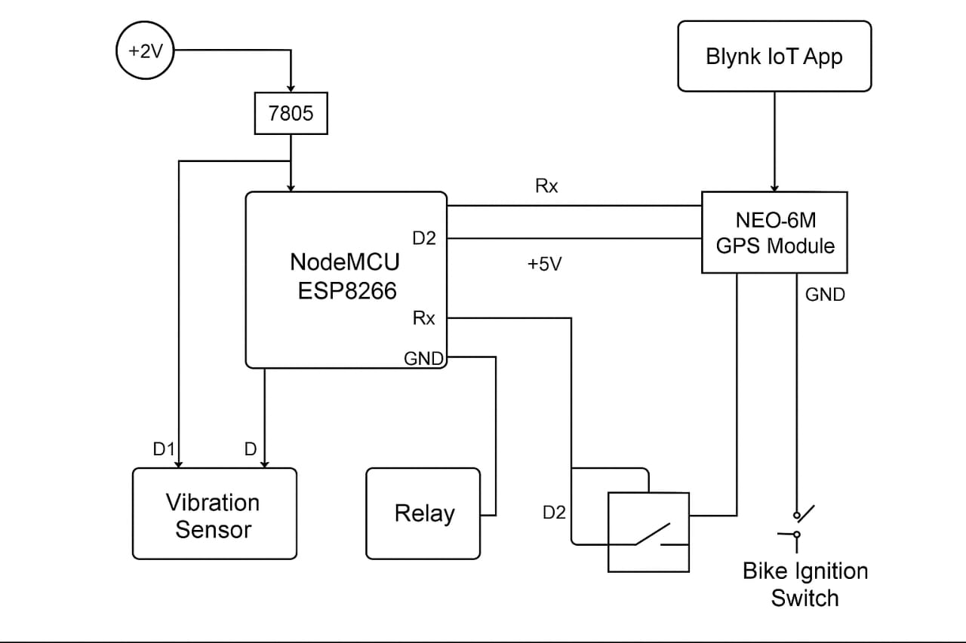
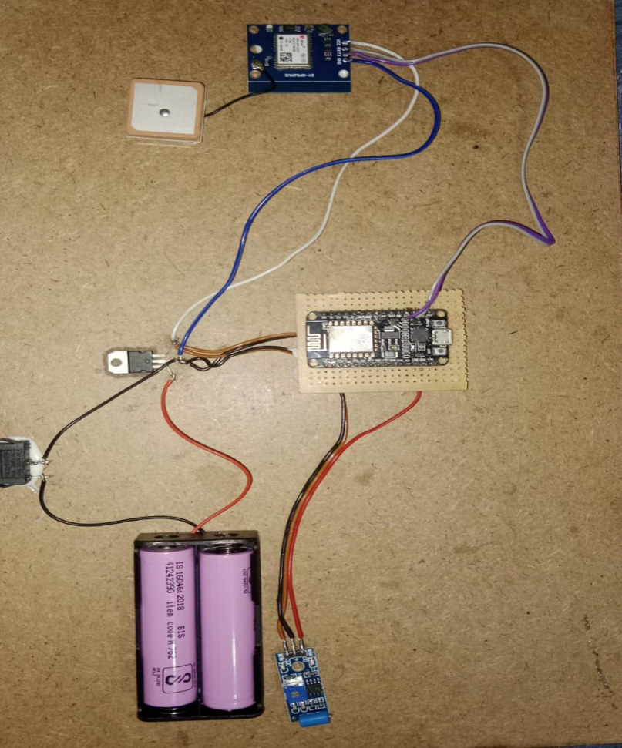
CIRCUIT DIAGRAM

Slide 10
CONCLUSION
The Bike Anti-Theft Alert System perfectly demonstrates how IoT technology can be used to lock up vehicles in a smart, affordable, and efficient manner. With the use of modules such as NodeMCU, GPS module, relay, and the Blynk app, the system provides real-time location tracking, immediate alert notifications, and remote ignition control—features typically found in high-end security systems.Lastly, the project succeeds in its objective of reducing risk of bike theft and facilitating users with real-time monitoring and management of their vehicle's security.

Slide 11
REFERENCES
G. Kaur, P. Sharma, “Smart Vehicle Anti-Theft System Using GSM and GPS,” International Journal of Engineering Research & Technology (IJERT), Vol. 6, Issue 6, 2017. https://www.ijert.org/smart-vehicle-anti-theft-system-using-gsm-and-gps
D. Patel, A. Desai, “IoT Based Smart Bike Security System Using NodeMCU,” International Journal of Scientific & Engineering Research (IJSER), Vol. 10, Issue 3, 2019. https://www.ijser.org/researchpaper/IoT-Based-Smart-Bike-Security-System-Using-NodeMCU.pdf
Blynk IoT Platform – Official Documentation. https://docs.blynk.io

